Slide 1
Introduction
Team Name : DevSquad
Theme : Clean and Green Energy

Slide 2
Team Detail
•Name of Team leader – Yash Sharma
•Name of Team Members
Nilesh Sharma
Mohit Ghanghas
Mukul Yadav

Slide 3
Problem Statement
Green Energy Marketplace for trading carbon credits and renewable resources.

Slide 4
Problem Statement
Sustainability Focus: Growing need for green energy and carbon credit trading.
Platform Gaps: No centralized, user-friendly marketplace.
Fraud Issues: Inefficient verification fosters mistrust.
Limited Access: Small entities face barriers in sustainability efforts.
Measurement Challenges: Difficulty tracking carbon footprints.
Missed Goals: Organizations struggle to meet climate targets.
Solution Gap: Need for a transparent, inclusive, and efficient platform.

Slide 5
Technical Description
Tech Stack
Frontend: React.js, Tailwind CSS
Backend: Node.js with Express.js
Database: MongoDB
Blockchain: Ethereum/Hyperledger for secure, traceable transactions
Core Features
Carbon Credit Trading: Purchase and sell verified carbon credits seamlessly.
Renewable Energy Marketplace: Direct trading of solar, wind, and biomass energy.
Emission Calculator: Calculate carbon footprints with tailored offset recommendations.
Transparency: Blockchain ensures fraud-free, traceable transactions.
Certificates & Rewards: Receive instant digital certificates and earn gamified rewards for contributions.

Slide 6
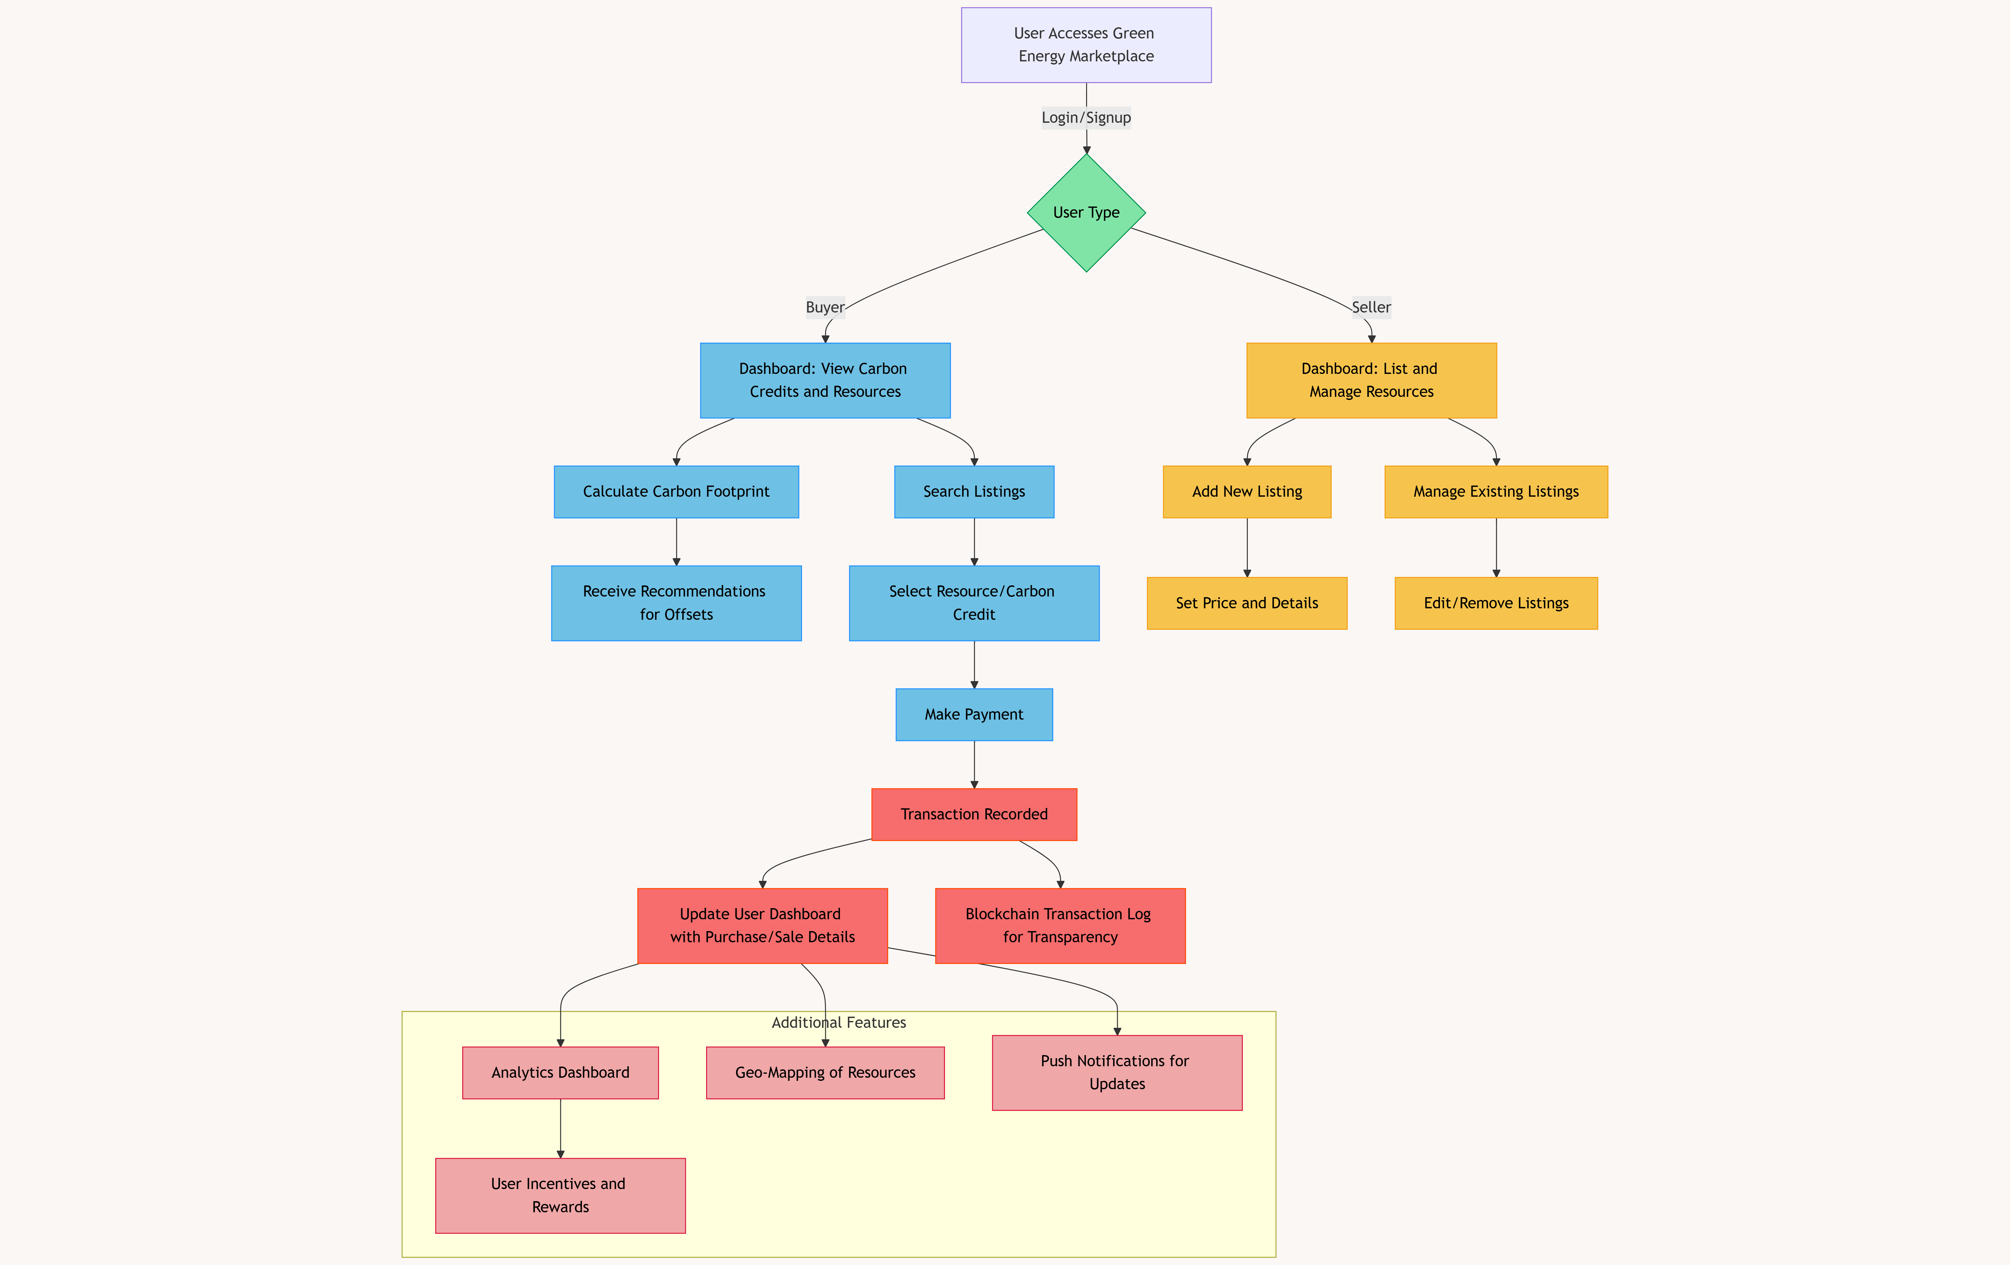
Flow Chart :-

Slide 7
Solution of the Problem
The Green Energy Marketplace addresses the problem by creating a transparent and accessible platform for trading carbon credits and renewable energy resources.
Key Features:
Marketplace for Trading:
Buyers can search and filter listings of carbon credits or renewable energy resources.
Sellers can list their surplus resources and set dynamic prices.
Carbon Footprint Calculator:
Users can estimate their greenhouse gas emissions based on activities like electricity usage, transportation, and waste generation.
Recommendations are provided for reducing emissions and purchasing appropriate offsets.

Slide 8
4.Transparent Transactions:
Blockchain-based recording of transactions ensures transparency and prevents fraud.
Payment gateways enable secure and efficient monetary transactions.
5.Analytics and Reports:
Dashboards for buyers and sellers to track purchases, sales, and environmental impact.
Visualizations to showcase emission reductions and trading trends.
6.Geo-Mapping of Resources:
Integrates Google Maps API to display nearby renewable energy sellers.
7.Push Notifications:
Alerts for price changes, new listings, and promotions.
8.Incentive Programs:
Gamification elements to encourage eco-friendly behaviors, such as earning badges or rewards.

Slide 9
Metrics and Feasibility
Market Opportunity:
Global carbon credit market size: $300 billion+ by 2030.
Renewable energy demand is growing at 8.4% annually.
Impact Projections:
Potential reduction of 1 million tons of CO₂ annually if adopted by 10,000 users.
Onboard 1,000 users within the first six months
Feasibility:
Tech Stack: Leverages proven tools like React, Node.js, and blockchain.
Scalable Model: Designed for small-scale pilots with easy expansion.

Slide 10
Integration into CityEase:
The marketplace complements CityEase’s goal of improving urban living by promoting sustainable practices within cities.
Provides an additional tool for citizens to contribute to the city’s environmental goals.
Future Enhancements:
Mobile app development for on-the-go trading.
AI-powered recommendations for green energy solutions.
Partnerships with government bodies to validate carbon credits.
Educational resources to raise awareness about carbon footprints.
Conclusion: The Green Energy Marketplace within CityEase is a step towards a sustainable future, empowering individuals and businesses to actively participate in reducing their environmental impact. By providing a transparent, efficient, and user-friendly platform, the project addresses the critical challenge of bridging the gap between green energy adoption and practical implementation.

Slide 11

Thanks

